Slide 1
2015.06.22(Mon)
Term Project
DC Motor speed control with compensator
Class : | Physical System Modeling and Control
Instructor : | Prof. Park, Kyi Hwan
Members : | 20151049 최윤정 20151160 Abdullah Tahir

Slide 2
Contents
1
Motor Analysis
2
Lead-Lag Compensator
3
Feedback

Slide 3
Overview
Block diagram
Block diagram of complete system
V ref
+
Controller
Power
Amp
Plant
Velocity
-
Incremental Encoder Feedback
Subtractor
Lead-Lag Compensator
LM675 Operational Amplifier can provide 3A current and ±30V so we will use this for supplying power to Plant
Armature Controlled Brushed DC Motor

Slide 4
1
Motor Analysis
(Time Domain and Frequency Domain)

Slide 5
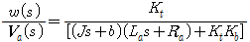
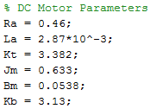
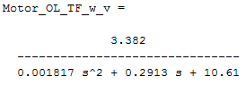
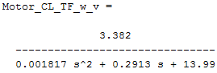
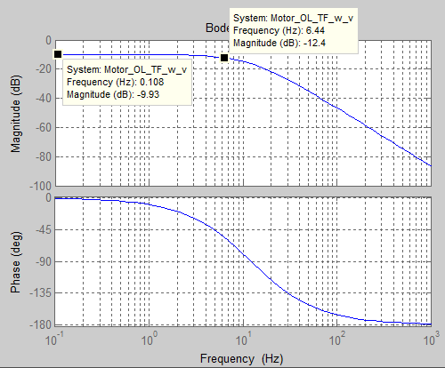
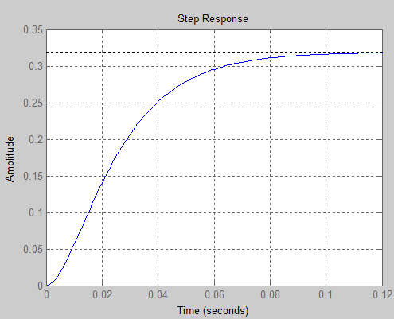
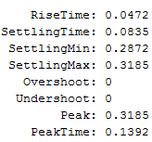
1. Motor Analysis
ω/v Open Loop Frequency and Time Response
Ess: 0.67
GainMargin: Inf (at Inf Hz)
PhaseMargin: Inf
Bandwidth: 7Hz
Notes:
Closed

Slide 6
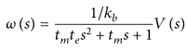
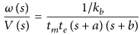
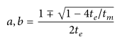
1. Motor Analysis
Tm = KT Ia = J d²θ/dt² + B dθ/dt
At constant angular velocity (under constant voltage)
KT Ia = B dθ/dt
B = KT Ia / ω
Notes:
Closed

Slide 7
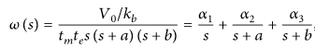
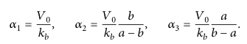
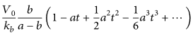
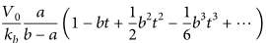
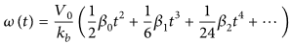
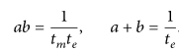
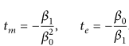
1. Motor Analysis
Notes:
Closed

Slide 8
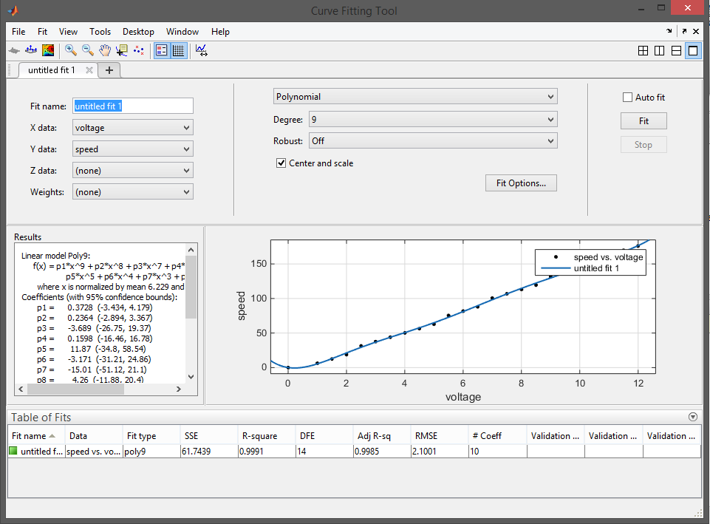
1. Motor Analysis
Notes:
Closed

Slide 9
2
Lead-Lag Compensator

Slide 10
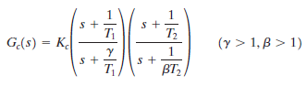
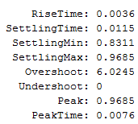
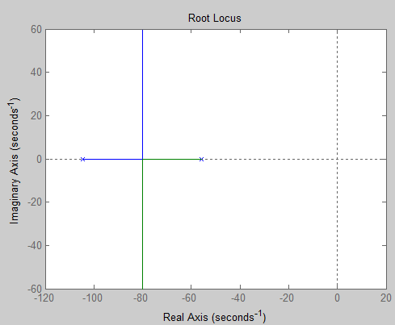
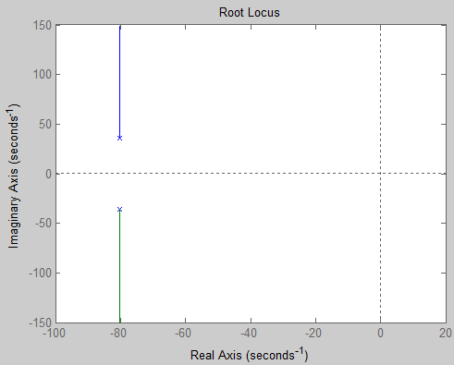
2. Lead-Lag Compensator
Poles Location = -424.26±426.26j
Open Loop
Close Loop

Slide 11
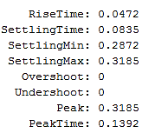
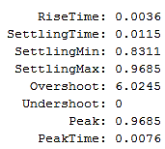
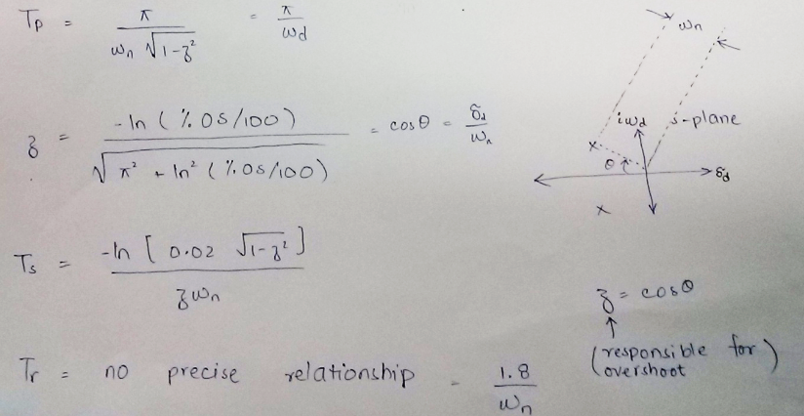
2. Lead-Lag Compensator
Ess: 0.67
Ess: 0.09

Slide 12
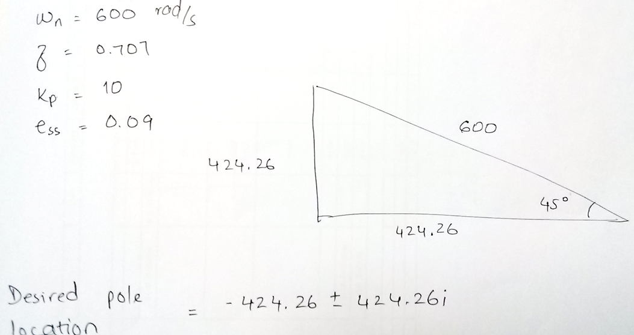
2. Lead-Lag Compensator
Compensator Design
Desired Pole Location

Slide 13
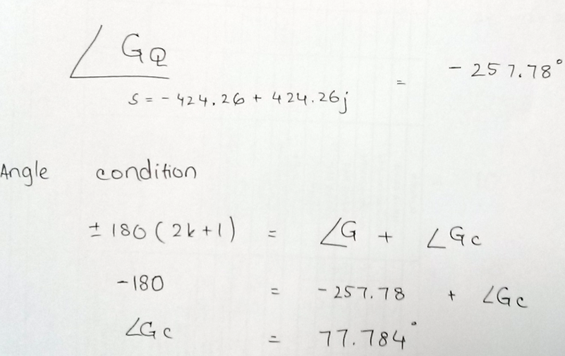
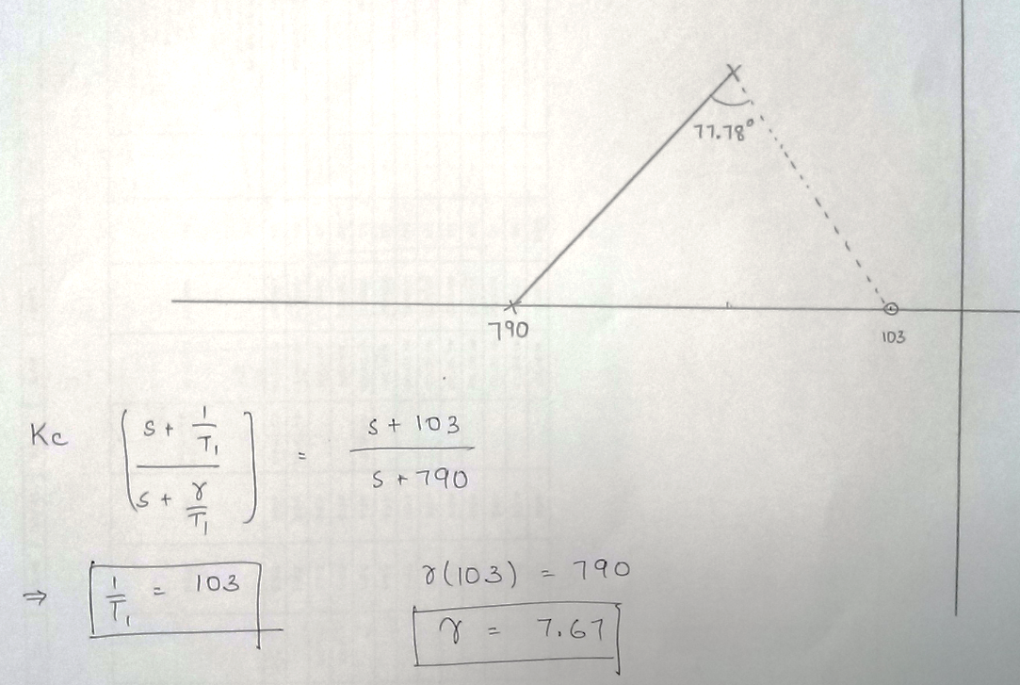
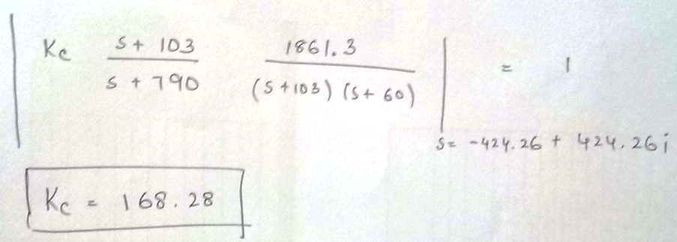
2. Lead-Lag Compensator
Angle to be provided by Lead Compensator
Find the values of Lead part

Slide 14
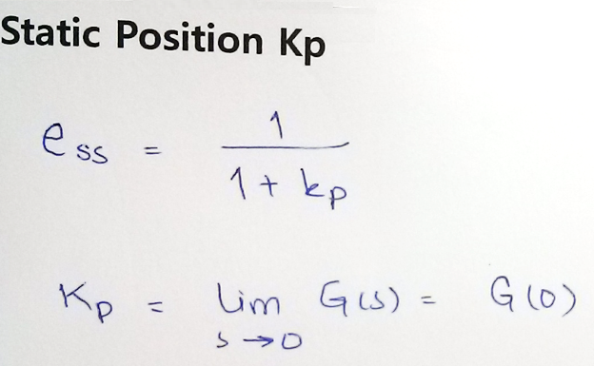
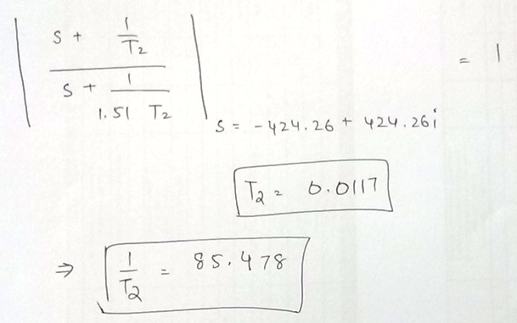
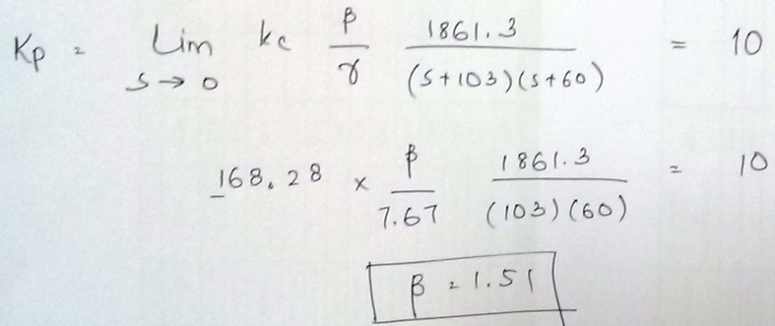
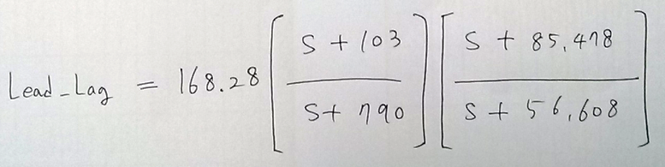
2. Lead-Lag Compensator
Find the values of Lag Part
&
Lead – Lag Compensator according to required specifications

Slide 15
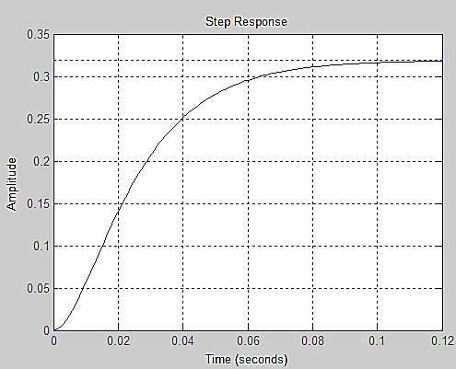
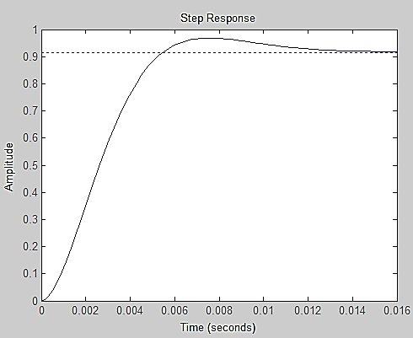
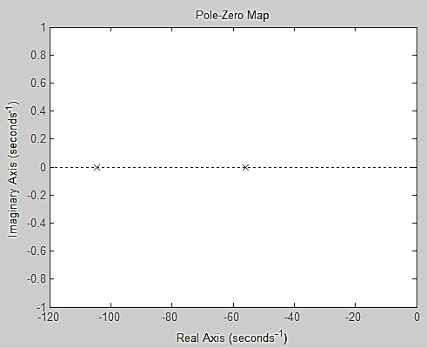
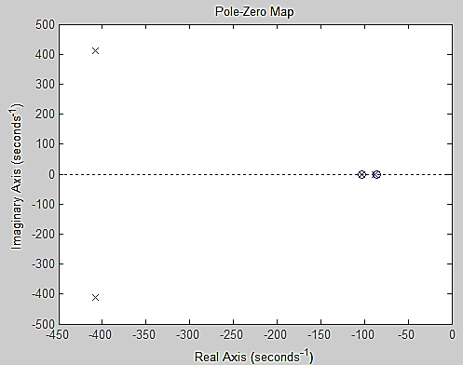
2. Lead-Lag Compensator
Comparison in Time Domain [Unit Step Input]
Uncompensated System
Compensated System
Ess: 0.67
Ess: 0.09
Dominant Poles at Desired Location
Poles Not at Desired Location

Slide 16
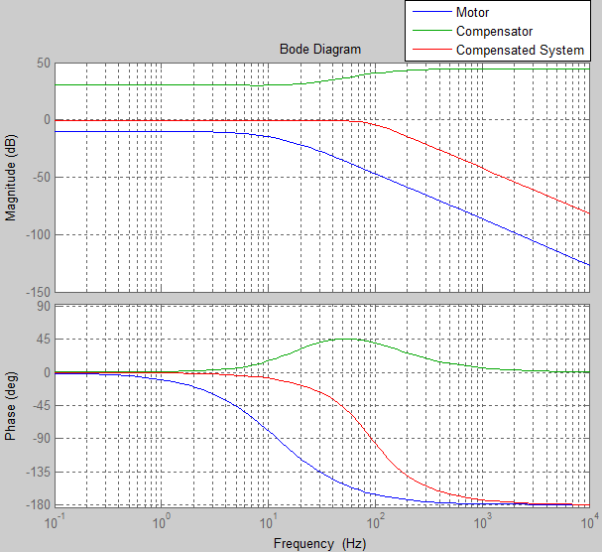
2. Lead-Lag Compensator
Comparison in Frequency Domain [Bode Plot]
Motor Open Loop
Gain Margin = Inf dB (at Inf Hz)
Phase Margin = Inf
Bandwidth = 7Hz
Motor Close Loop
Gain Margin = Inf dB (at Inf Hz)
Phase Margin = Inf
Bandwidth = 10Hz
Compensated System
Gain Margin = Inf dB (at Inf Hz)
Phase Margin = Inf
Bandwidth = 85Hz

Slide 17
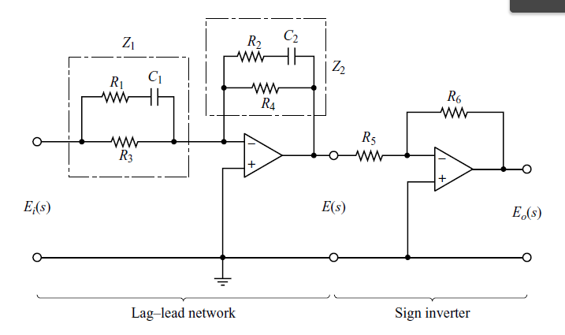
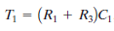
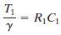
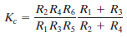
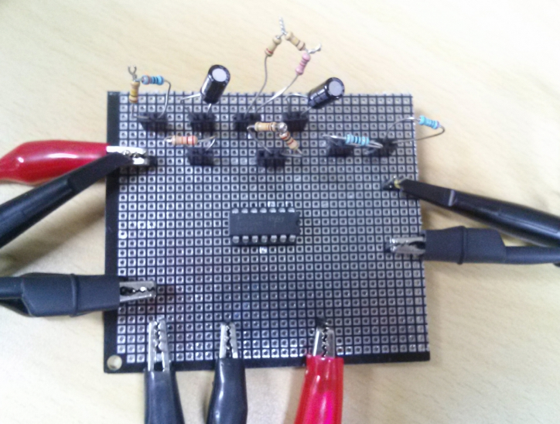
2-2. Lead-Lag Compensator
Circuit
Calculate the value of parameters
C1 = C2 =0.1uF
R1 = 12658 Ω
R2 = 116989 Ω
R3 = 84429 Ω
R4 = 59664 Ω
R5 = 1000 Ω
R6 = 46880 Ω

Slide 18
³Feedback

Slide 19
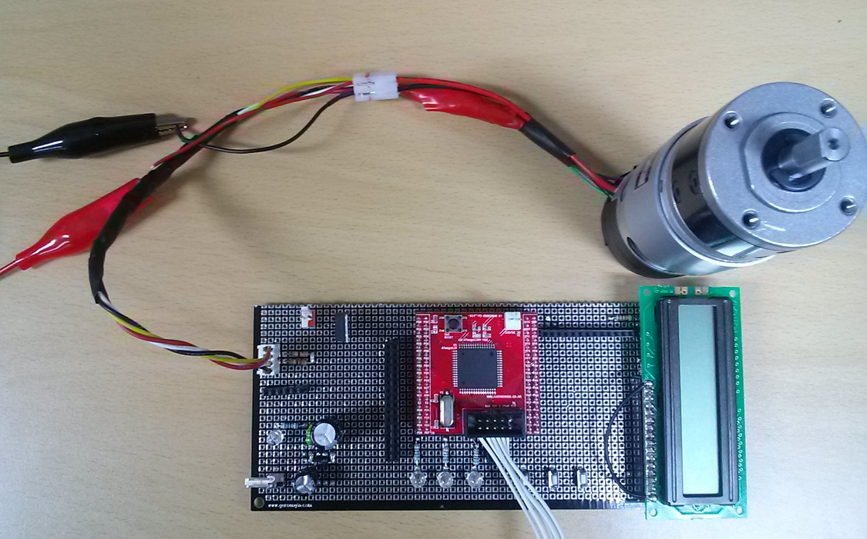
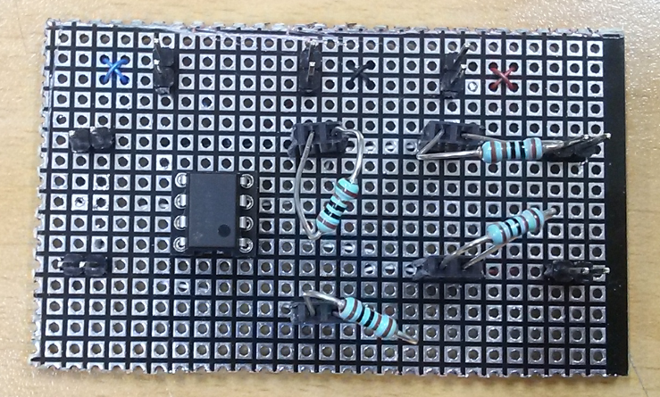
3. Feedback
Feedback is being sent to Subtractor via ATMEGA uController
Incremental Shaft Encoder uController Subtractor
uController will display the angular velocity and will control DAC
^{MCU Board}
^{Subtractor}

Slide 20
Thank You

